Slide 1
KEYNOTE SESSION: The Essential Value of Good Suppliers
How to Identify and Select the Right Suppliers as a Part of your PMTA and What to Do if You Need to Change Suppliers Along the Way.
Mike Bond
Bonnie Coffa, PhD, DABT
Labstat
Chemular
JANUARY 30 | 11:00AM - 11:30AM

Slide 2


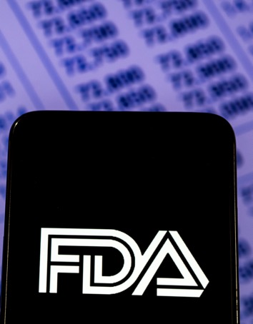


What can happen if you select the wrong testing lab (supplier)?
Spend more money
Testing takes longer
FDA issues deficiency letter because methods and validation reports not in a lab TPMF
Bad data
Start testing all over

Slide 3
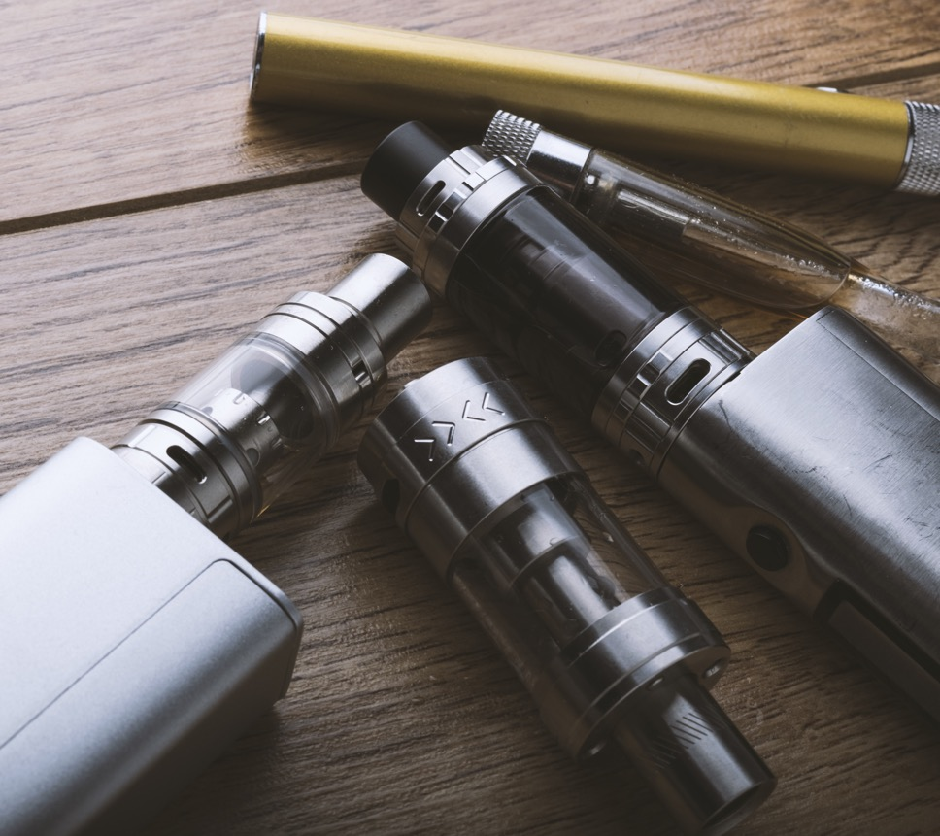
PMTA Landscape
FDA’s Application Review status FY 20-23
26 million applications received, mostly e-cigs
99% have been rejected in some way
23 marketing authorizations for e-cigarettes (MGO)

Slide 4
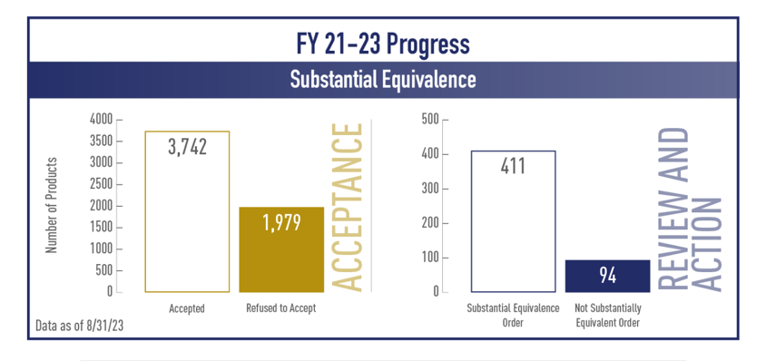
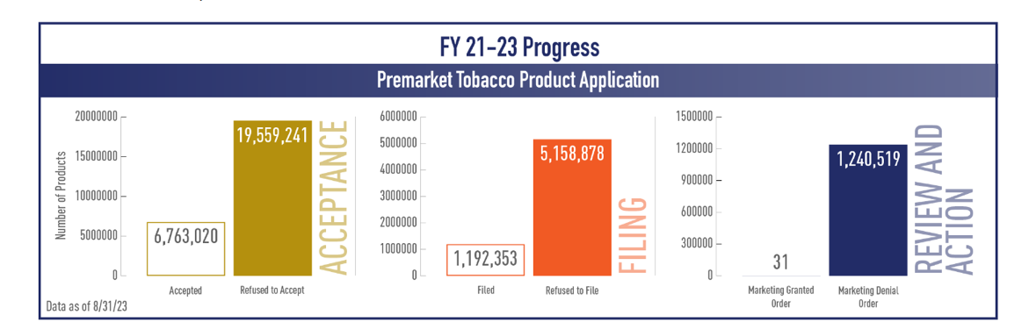
FDA Rejections – They Didn’t Have the Science
RTA – Applications failed to meet the “minimum threshold for scientific review” (missing information)
MDO – Missing or incomplete scientific details; failure to adequately address impact on public health (quality of the information)
RTA = Refuse to accept
MDO = Marketing Denial Order

Slide 5
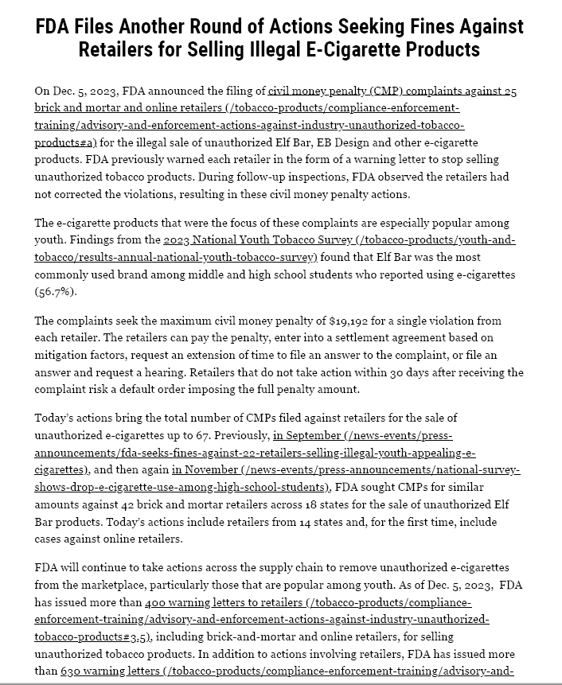
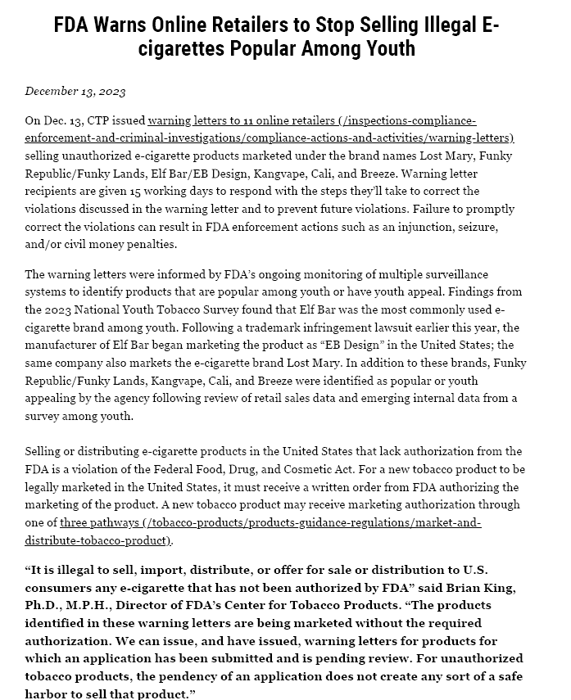
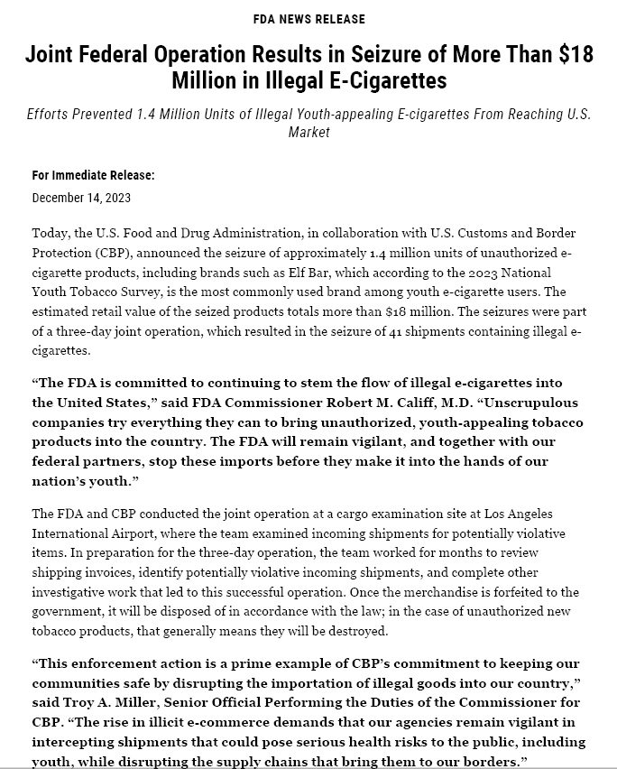
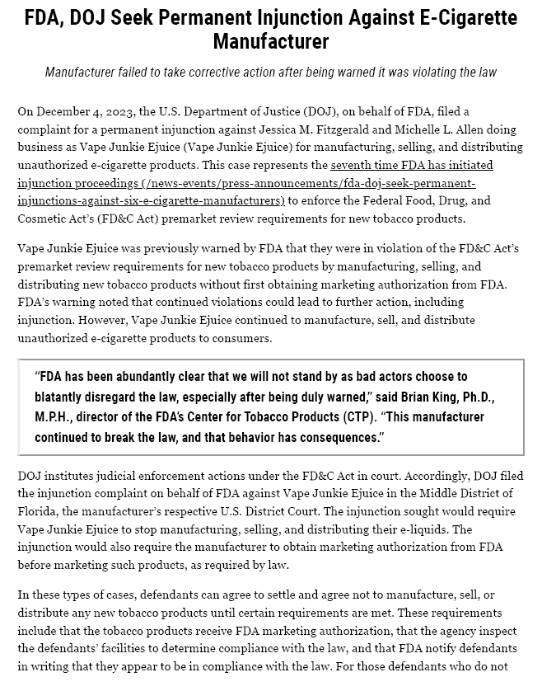
FDA Action Ramped Up in 2023

Slide 6
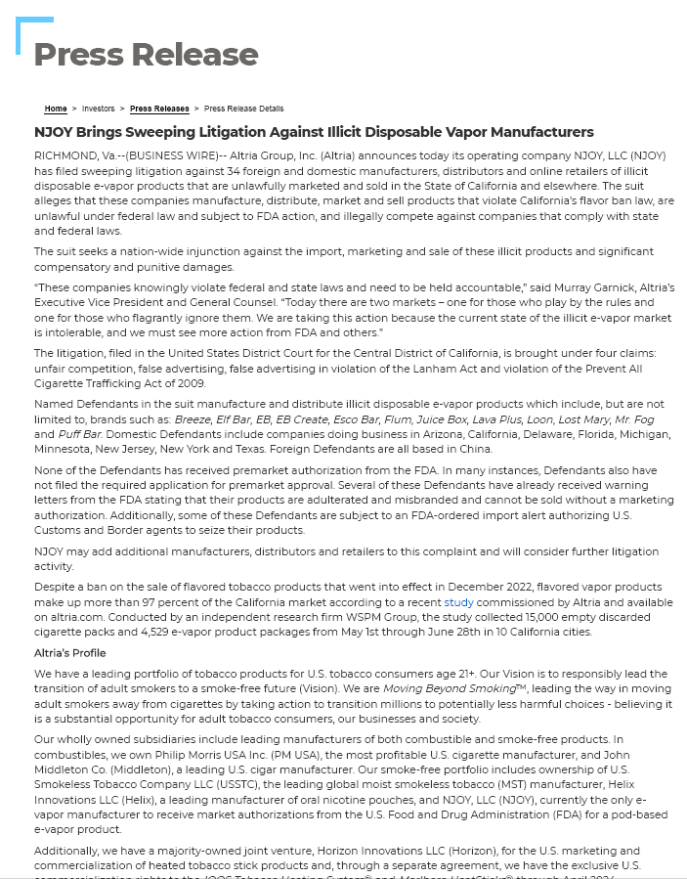
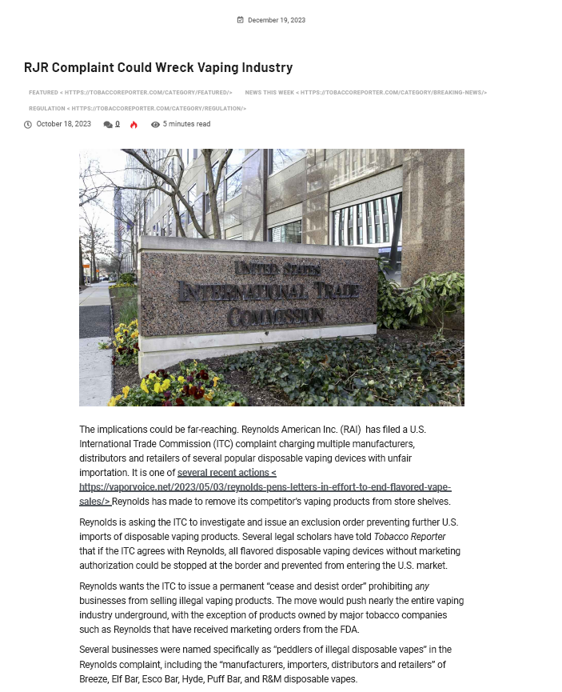
Major Manufacturers are Pressing for Action

Slide 7
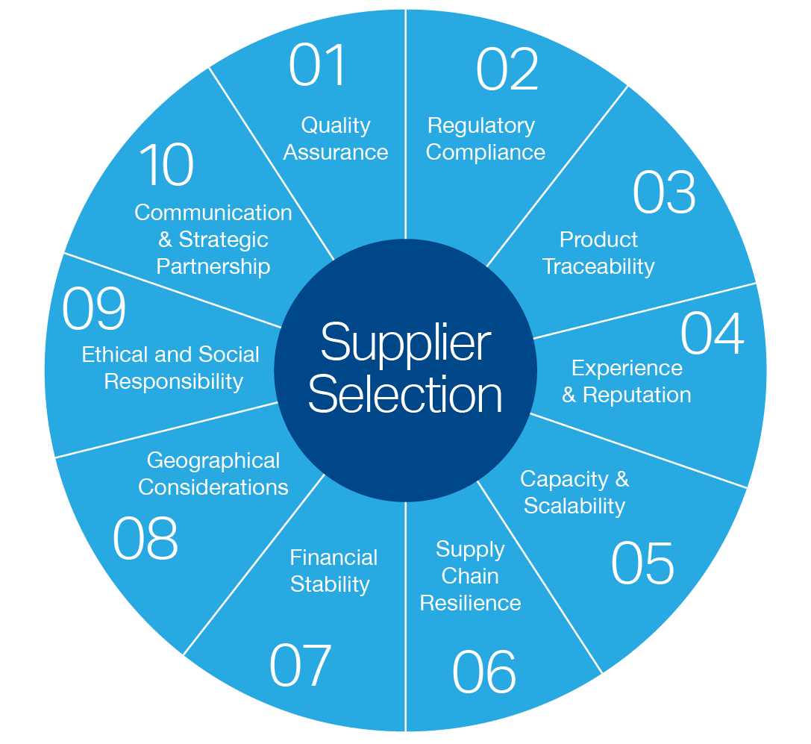
How to Identify & Select The Right Supplier
Supplier selection ensures quality and consistency of materials (essential for meeting regulatory standards). A reliable supplier helps maintain product integrity, reduces contamination risk, and improves cost-effectiveness.

Slide 8

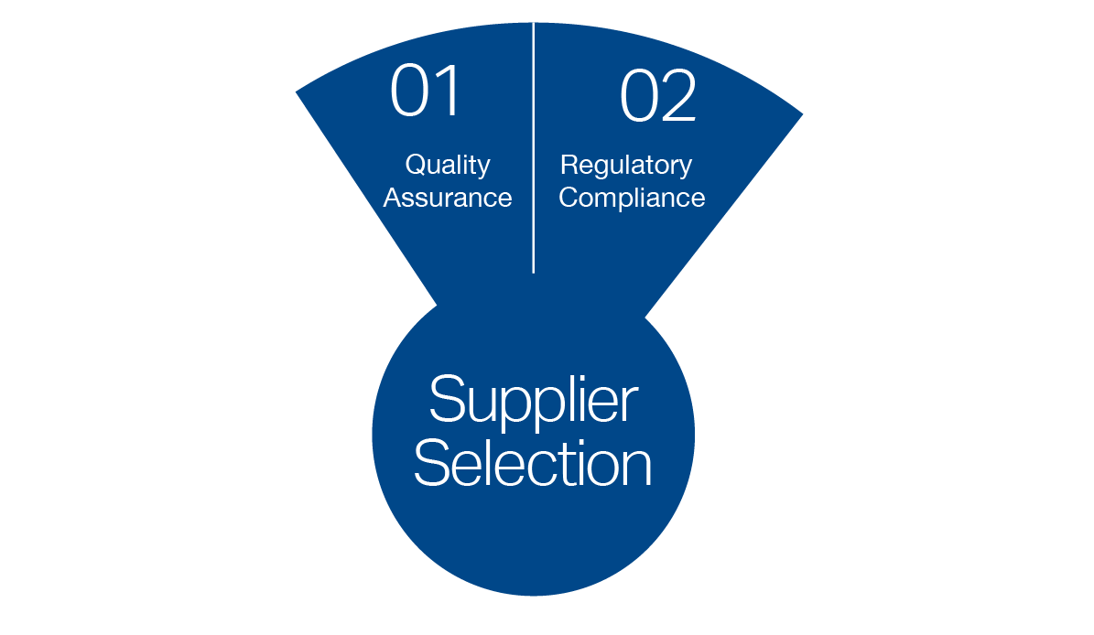
Regulatory Compliance & Quality Assurance
The Act¹ stipulates use of and documented proof that your testing lab is accredited.
ISO 17025, GLP², OECD
Key QMS Attributes:
Robust policies and procedures for confidentiality
ICH-compliant validations
Participation in proficiency testing programs
Sample isolation to avoid cross-contamination
Checks and balances for data review accuracy
1. § 1114.7(i)(4)(i)), 2. 21CFR Part 58

Slide 9
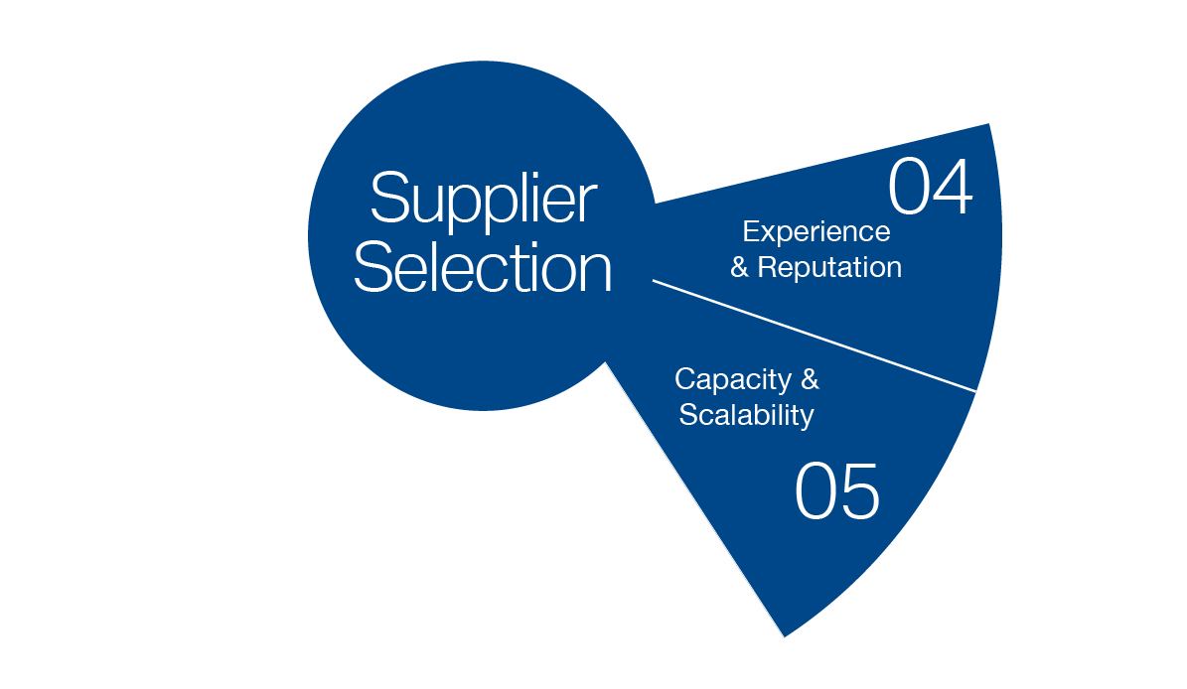
Expertise specific to the Tobacco/Nicotine Space
Validations specific to tobacco/nicotine products
Has an FDA Tobacco Product Master File (TPMF)
Active in organizations that drive good science in the industry
CORESTA, ISO, ASTM
Depth of experience with a wide range of regulatory submission types
Experience with multiple stakeholders for reputation and broad perspective
Projects with Manufacturers, government organizations, academia, non-profit associations
Formal presentations and peer-reviewed publications

Slide 10

Experience & Offerings
PMTA requires assessment and insights from the manufacturer
In addition to specific analytes, FDA requires: “Other constituents, as appropriate for your particular product.”
Does your vendor offer…
Insight into other constituents?
Custom methods development?
Complex/custom statistical evaluation?
Customized/automated data handling?

Slide 11

Capacity & Scalability
Chemistry
Microbial and Toxicology
Environmental
Varied puffing regimes for some products
Clinical and bio-analytical
Shelf-life studies
Capacity & agility to prioritize deficiency letters
sometimes with only a few weeks or months to respond

Slide 12
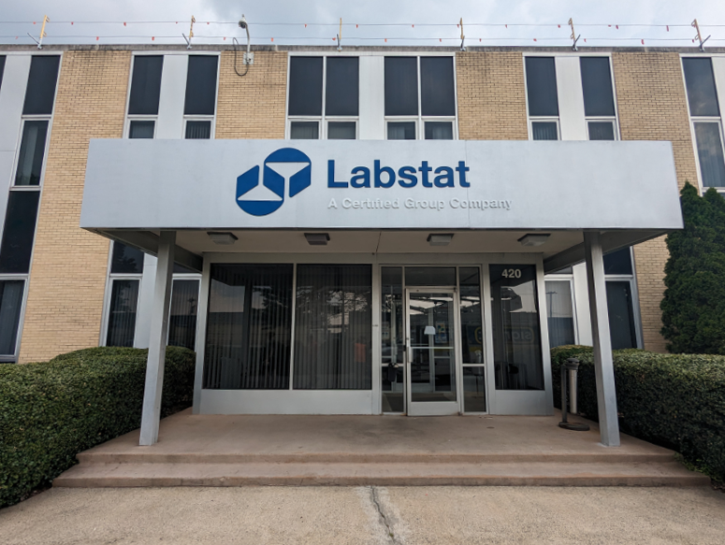
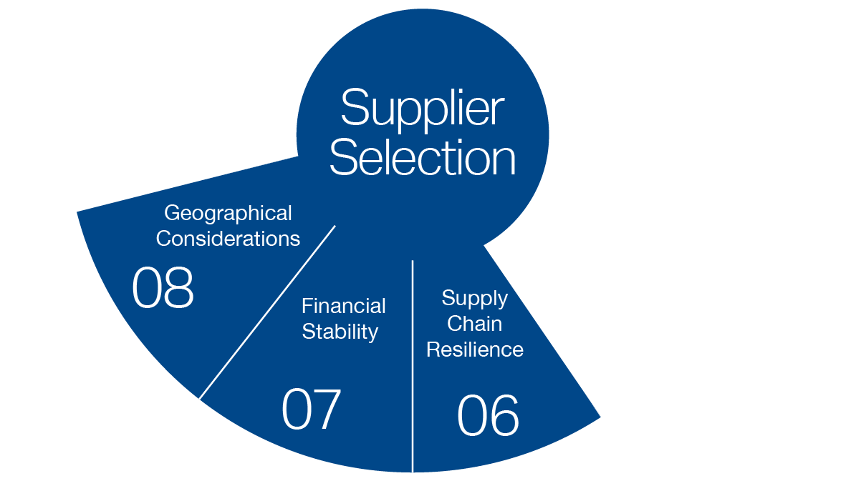
Business Continuity
Redundancy equipment
Back-up power for stability storage
Multiple sites, networked laboratories
Full redundancy for microbiological work

Slide 13

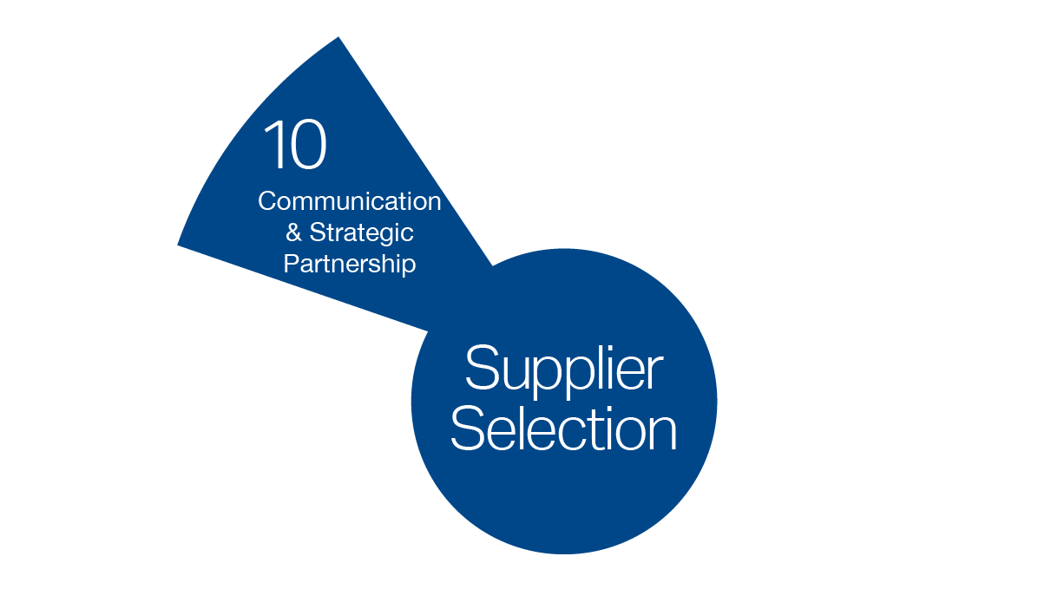
Strategic with Testing Plan
Strategic testing (pilot, prototype, bridging)
Budget can influence testing cadence (file amendments)
Develop testing plan to prioritize data generation and study plans for future testing
“Basically, show FDA you are doing the right thing”

Slide 14
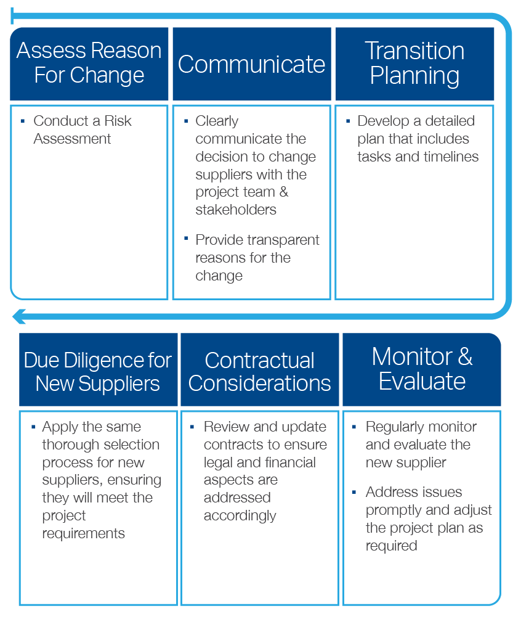
Changing Suppliers Along the Way
What if you need to change suppliers? Approach the process strategically and focus on minimizing risks and maintaining project continuity.

Slide 15

Visit the Labstat Website
How can we help you?
Request a meeting at TPE in your message

